Slide 1

Principles of Macroeconomics
Twelfth Edition, Global Edition
Chapter 4
Demand and Supply Applications

Slide 2
The Price System: Rationing and Allocating Resources
Price Rationing
price rationing The process by which the market system allocates goods and services to consumers when quantity demanded exceeds quantity supplied.
تقنين الأسعار: هي العملية التي يقوم من خلالها نظام السوق بتخصيص السلع والخدمات للمستهلكين عندما تتجاوز الكمية المطلوبة الكمية المعروضة.
The adjustment of price is the rationing mechanism in free markets.
Price rationing means that whenever there is a need to ration a good—that is, when a shortage exists—in a free market, the price of the good will rise until quantity supplied equals quantity demanded—that is, until the market clears.

Slide 3
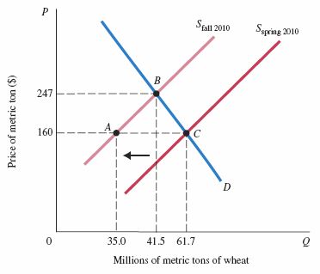
FIGURE 4.1 The Market for Wheat
Fires in Russia in the summer of 2010 caused a shift in the world’s supply of wheat to the left, causing the price to increase from $160 per metric ton to $247.
The equilibrium moved from C to B.

Slide 4
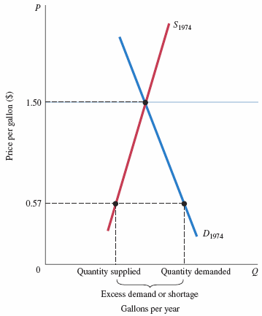
FIGURE 4.3 Excess Demand (Shortage) Created by a Price Ceiling
In 1974, a ceiling price of $0.57 per gallon of leaded regular gasoline was imposed.
If the price had been set by
the interaction of supply and demand instead, it would have increased to approximately $1.50 per gallon.
At $0.57 per gallon, the quantity demanded exceeded the quantity supplied.
Because the price system was not allowed to function, an alternative rationing system had to be found to distribute the available supply of gasoline.

Slide 5
Constraints on the Market and Alternative Rationing Mechanisms (4 of 6)
price ceiling A maximum price that sellers may charge for a good, usually set by government.
queuing Waiting in line as a means of distributing goods and services: a nonprice rationing mechanism.
يظهر الاصطفاف عادةً عندما:
يكون السعر منخفضًا أو ثابتًا
والطلب أكبر من العرض
ولا يُسمح للسعر بالارتفاع لتحقيق التوازن
favored customers Those who receive special treatment from dealers during situations of excess demand.

Slide 6
Constraints on the Market and Alternative Rationing Mechanisms (5 of 6)
ration coupons Tickets or coupons that entitle individuals to purchase a certain amount of a given product per month. (non price)
black market A market in which illegal trading takes place at market-determined prices.

Slide 7
Constraints on the Market and Alternative Rationing Mechanisms (6 of 6)
Rationing Mechanisms for Concert and Sports Tickets
It is very difficult to prevent the price system from operating and to stop people’s willingness to pay from asserting itself.
Every time an alternative is tried, the price system seems to sneak in the back door.
With favored customers and black markets, the final distribution may be even more unfair than what would result from simple price rationing.

Slide 8
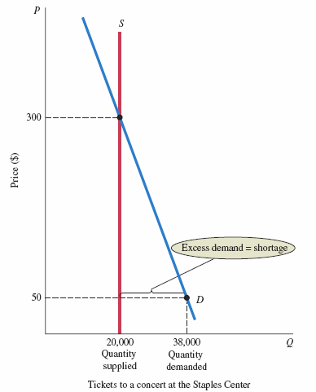
FIGURE 4.4 Supply of and Demand for a Concert at the Staples Center
At the face-value price of $50, there is excess demand for seats to the concert.
At $50 the quantity demanded is greater than the quantity supplied, which is fixed at 20,000 seats.
The diagram shows that the quantity demanded would equal the quantity supplied at a price of $300 per ticket.

Slide 9
Price Floor
price floor A minimum price below which exchange is not permitted.
minimum wage A price floor set for the price of labor.

Slide 10
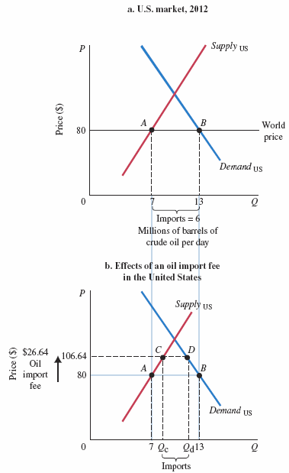
FIGURE 4.5 The U.S. Market for Crude Oil, 2012
In 2012 the world market price for crude oil was approximately $80 per barrel.
Domestic production in the United States that year averaged about 7 million barrels per day,
whereas crude oil demand averaged just under 13 million barrels per day.
The difference between production and consumption were made up of net imports of approximately 6 million barrels per day, as we see in panel (a).
If the government imposed a tax in this market of 33.33%, or $26.64, that would increase the world price to $106.64.
That higher price caused quantity demanded to fall below its original level of 13 million barrels, while the price increase caused domestic production to rise above the
original level.
As we see in panel (b), the effect was a reduction in import levels.

Slide 11
Supply and Demand and Market Efficiency
Supply and demand curves can be used to illustrate market efficiency, which can be understood through the concepts of consumer and producer surplus.
Consumer Surplus
consumer surplus The difference between the maximum amount a person is willing to pay for a good and its current market price.
فائض المستهلك: الفرق بين أقصى مبلغ يرغب الشخص في دفعه مقابل سلعة ما وسعرها الحالي في السوق.

Slide 12
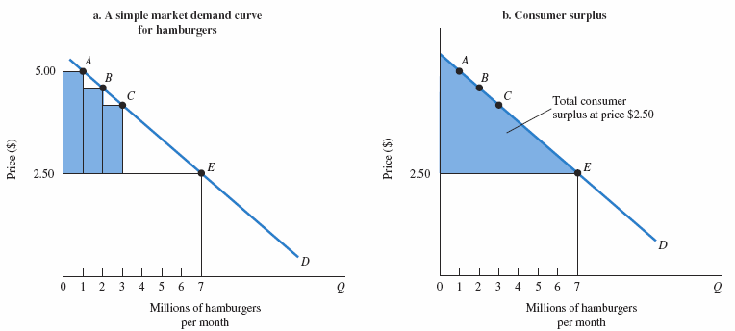
FIGURE 4.6 Market Demand and Consumer Surplus
As illustrated in panel (a), some consumers (see point A) are willing to pay as much as $5.00 each for hamburgers. Since the market price is just $2.50, they receive a consumer surplus of $2.50 for each hamburger that they consume.
Others (see point B) are willing to pay something less than $5.00 and receive a slightly smaller surplus.
Because the market price of hamburgers is just $2.50, the area of the shaded triangle in panel (b) is equal to total consumer surplus.

Slide 13
Producer Surplus
producer surplus The difference between the current market price and the cost of production for the firm.

Slide 14
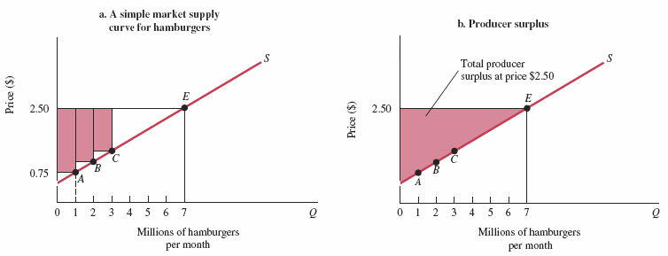
FIGURE 4.7 Market Supply and Producer Surplus
As illustrated in panel (a), some producers are willing to produce hamburgers for a price of $0.75 each. Since they are paid $2.50, they earn a producer surplus equal to $1.75.
Other producers are willing to supply hamburgers at prices less than $2.50, and they also earn producer surplus. Because the market price of hamburgers is $2.50, the area of the shaded triangle in panel (b) is equal to total producer surplus.

Slide 15
Competitive Markets Maximize the Sum of Producer and Consumer Surplus
deadweight loss The total loss of producer and consumer surplus from underproduction or overproduction.
الخسارة الصافية: إجمالي الفائض (فائض المستهلك + فائض المنتج) الذي يفقده المجتمع نتيجة عدم إنتاج أو عدم استهلاك الكمية الكفؤة من السلعة.

Slide 16
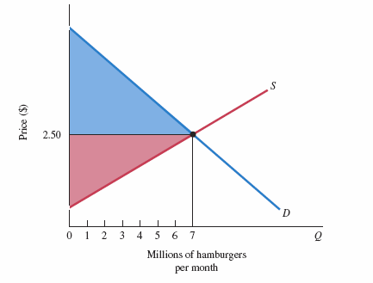
FIGURE 4.8 Total Producer and Consumer Surplus
Total producer and consumer surplus is greatest where supply and demand curves intersect at equilibrium.

Slide 17
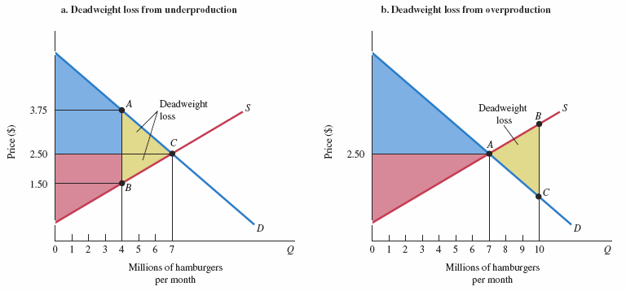
FIGURE 4.9 Deadweight Loss
Panel (a) shows the consequences of producing 4 million hamburgers per month instead of 7 million hamburgers per month. Total producer and consumer surplus is reduced by the area of triangle ABC shaded in yellow. This is called the deadweight loss from underproduction.
Panel (b) shows the consequences of producing 10 million hamburgers per month instead of 7 million hamburgers per month. As production increases from 7 million to 10 million hamburgers, the full cost of production rises above consumers’ willingness to pay, resulting in a deadweight loss equal to the area of triangle ABC.

Slide 18
Potential Causes of Deadweight Loss from Under- and Overproduction
Competitive markets are efficient because when supply and demand interact freely, markets produce what people want at the least cost.
There are a number of sources of market failure:
  Monopoly power gives firms the incentive to underproduce and overprice.
  Taxes and subsidies may distort consumer choices.
  External costs such as pollution and congestion may lead to over- or underproduction of some goods.
  Artificial price floors and price ceilings may have the same effects.

