Slide 1

Principles of Economics
Twelfth Edition
Chapter 2
The Economic Problem: Scarcity and Choice

Slide 2
Chapter Outline and Learning Objectives
2.1 Scarcity, Choice, and Opportunity Cost
2.2 Economic Systems and the Role of Government
كيف نُشبع حاجات غير محدودة باستخدام موارد محدودة؟
ومن هنا تظهر ثلاثة مفاهيم محورية:
الندرة
الاختيار
تكلفة الفرصة البديلة

Slide 3
Chapter 2 The Economic Problem: Scarcity and Choice ( 1 of 2)
On the surface, economic issues seem quite different from one another.
But the fundamental concern is choice in a world of scarcity.
Individuals’ choices determine three key features of society:: (3 basic questions)
  What gets produced? What to produce?
  How is it produced? How is it produced?
  Who gets what is produced? For whom
الندرة
الموارد الاقتصادية محدودة الحاجات الإنسانية غير محدودةلذلك لا يمكن إنتاج كل شيء نريده
2. الاختياربسبب الندرة، يجب أن نختار:
ماذا ننتج؟
كيف ننتج؟
لمن ننتج؟
هذه تُسمى الأسئلة الاقتصادية الثلاثة الأساسية.

Slide 4
Chapter 2 The Economic Problem: Scarcity and Choice ( 2 of 2)
factors of production (or factors) The inputs into the process of production. Another term for resources.
capital Things that are produced and then used in the production of other goods and services.
inputs or resources Anything provided by nature or previous generations that can be used directly or indirectly to satisfy human wants.
production The process that transforms scarce resources into useful goods and services.
outputs Goods and services of value to households.

Slide 5
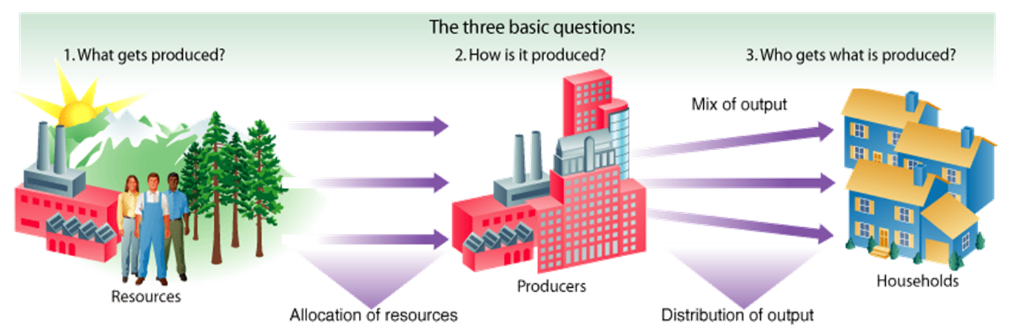
FIGURE 2.1 The Three Basic Questions
Every society has some system or process that transforms its scarce resources into useful goods and services.
In doing so, it must decide what gets produced, how it is produced, and to whom it is distributed.
The primary resources that must be allocated are land, labor, and capital.

Slide 6
The Production Possibility Frontier (1 of 7)
production possibility frontier (ppf) A graph that shows all the combinations of goods and services that can be produced if all of society’s resources are used efficiently.
Capital Goods and Consumer Goods
consumer goods : Goods produced for present consumption.
Capital Goods : Goods used in producing other goods.
investment The process of using resources to produce goods and services and new capital.

Slide 7
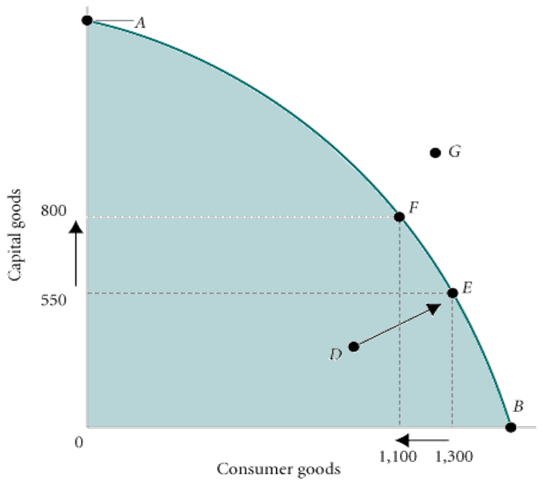
FIGURE 2.4 Production Possibility Frontier
The ppf illustrates a number of economic concepts. One of the most important is opportunity cost.
The opportunity cost of producing more capital goods is fewer consumer goods.
Moving from E to F, the number of capital goods increases from 550 to 800, but the number of consumer goods decreases from 1,300 to 1,100.

Slide 8
The Production Possibility Frontier (2 of 7)
Negative Slope and Opportunity Cost
marginal rate of transformation (MRT) The slope of the production possibility frontier (ppf).
The negative slope tells us how much society has to give up of one output to get a unit of another output.

Slide 9
FIGURE 2.4 Production Possibility Frontier
The ppf illustrates a number of economic concepts. One of the most important is opportunity cost.
The opportunity cost of producing more capital goods is fewer consumer goods.
Moving from E to F, the number of capital goods increases from 550 to 800, but the number of consumer goods decreases from 1,300 to 1,100.
Slope (MRT)= (800-550 ) ÷ (1100-1300) = -1.25

Slide 10
TABLE 2.1 Production Possibility Schedule for Total Corn and Wheat Production in Ohio and Kansas
Point on ppf | Total Corn Production (Millions of Bushels per Year) | Total Wheat Production (Millions of Bushels per Year)
A | 700 | 100
B | 650 | 200
C | 510 | 380
D | 400 | 500
E | 300 | 550
The ppf illustrates that the opportunity cost of corn production increases as we shift resources from wheat production to corn production. Moving from point E to D, we get an additional 100 million bushels of corn at a cost of 50 million bushels of wheat.
Moving from point B to A, we get only 50 million bushels of corn at a cost of 100 million bushels of wheat. The cost per bushel of corn—measured in lost wheat—has increased.

Slide 11
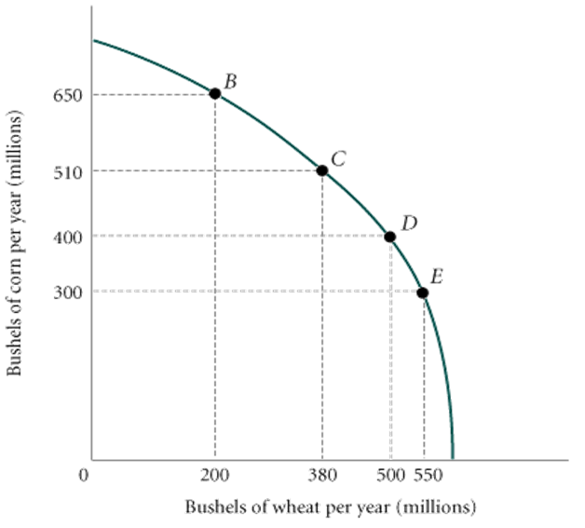
The Production Possibility Frontier (3 of 7)
The Law of Increasing Opportunity Cost
FIGURE 2.5 Corn and Wheat Production in Ohio and Kansas
The ppf illustrates that the opportunity cost of corn production increases as we shift resources from wheat production to corn production. Moving from point E to D, we get an additional 100 million bushels of corn at a cost of 50 million bushels of wheat.
Moving from point B to A, we get only 50 million bushels of corn at a cost of 100 million bushels of wheat. The cost per bushel of corn—measured in lost wheat—has increased.

Slide 12
The Production Possibility Frontier (4 of 7)
Unemployment
During economic downturns or recessions, industrial plants run at less than their total capacity.
When there is unemployment of labor, we are not producing all that we can.

Slide 13
The Production Possibility Frontier (5 of 7)
Inefficiency
Waste and mismanagement are the results of a firm operating below its potential.
Sometimes inefficiency results from mismanagement of the economy instead of mismanagement of individual private firms.

Slide 14
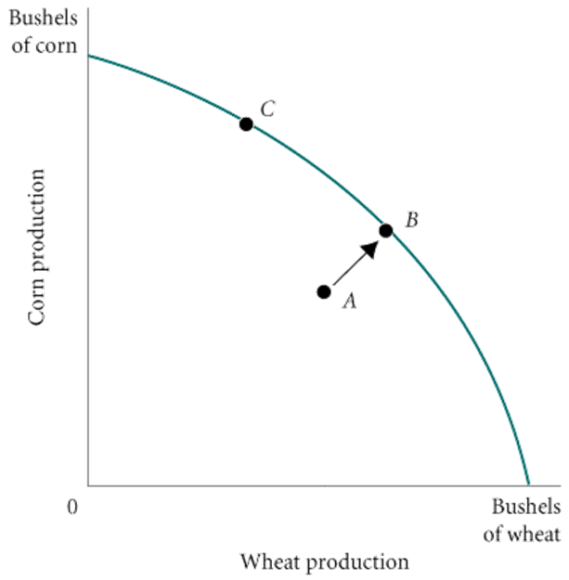
FIGURE 2.6 Inefficiency from Misallocation of Land in Farming
Inefficiency always results in a combination of production shown by a point inside the ppf, like point A.
Increasing efficiency will move production possibilities toward a point on the ppf, such as point B.

Slide 15
The Production Possibility Frontier (6 of 7)
The Efficient Mix of Output
To be efficient, an economy must produce what people want.
Output efficiency occurs when the economy is operating at the “right” point on the ppf.

Slide 16
The Production Possibility Frontier (7 of 7)
Economic Growth
economic growth An increase in the total output of an economy. Growth occurs when a society acquires new resources or when it learns to produce more using existing resources.
Growth shifts the ppf up and to the right.
النمو الاقتصادي هو زيادة في إجمالي الناتج الاقتصادي. ويحدث النمو عندما يكتسب المجتمع موارد جديدة أو عندما يتعلم كيفية إنتاج المزيد باستخدام الموارد المتاحة.

Slide 17
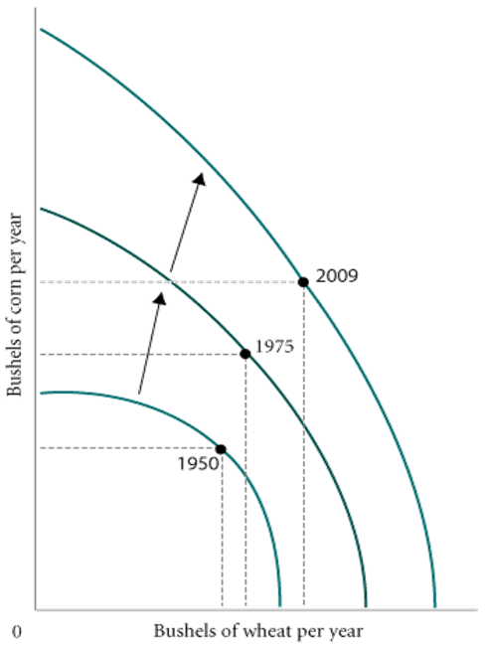
FIGURE 2.7 Economic Growth Shifts the PPF Up and to the Right
Productivity increases have enhanced the ability of the United States to produce both corn and wheat.
As Table 2.2 shows, productivity increases were more dramatic for corn than for wheat.
Thus, the shifts in the ppf were not parallel.
Notes:
Note: The ppf also shifts if the amount of land or labor in corn and wheat production changes. Although we emphasize productivity increases here, the actual shifts between years were due in part to land and labor changes.

Slide 18
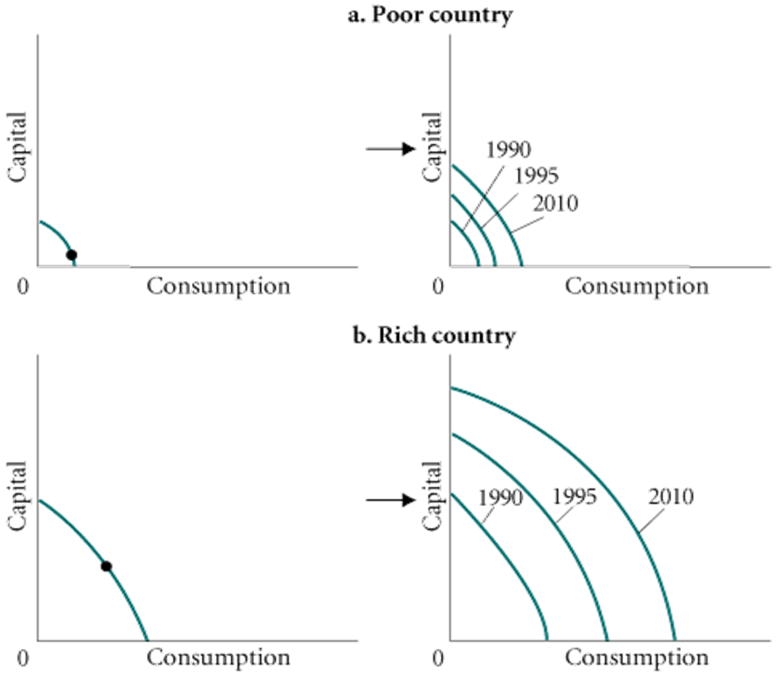
FIGURE 2.8 Capital Goods and Growth in Poor and Rich Countries
Rich countries find it easier than poor countries to devote resources to the production of capital, and the more resources that flow into capital production, the faster the rate of economic growth.
Thus, the gap between poor and rich countries has grown over time.

Slide 19
The Economic Problem
Recall the three basic questions facing all economic systems:
  What gets produced?
  How is it produced?
  Who gets it?
Given scarce resources, how do large, complex societies go about answering the three basic economic questions?

Slide 20
Economic Systems and the Role of Government (1 of 7)
Command Economies
command economy An economy in which a central government either directly or indirectly sets output targets, incomes, and prices.
الاقتصاد الموجه: اقتصاد تحدد فيه الحكومة المركزية، بشكل مباشر أو غير مباشر، أهداف الإنتاج والدخول والأسعار.
Laissez-Faire Economies: The Free Market
laissez-faire economy Literally from the French: “allow [them] to do.” An economy in which individual people and firms pursue their own self-interest without any central direction or regulationn.
اقتصاد السوق الحر: مصطلح فرنسي الأصل يعني "دعهم يفعلون". اقتصاد يسعى فيه الأفراد والشركات لتحقيق مصالحهم الذاتية دون أي توجيه أو تنظيم مركزي.

Slide 21
Economic Systems and the Role of Government (2 of 7)
market The institution through which buyers and sellers interact and engage in exchange.
Some markets are simple and others are complex, but they all involve buyers and sellers engaging in exchange.
The behavior of buyers and sellers in a laissez-faire economy determines what gets produced, how it is produced, and who gets it.

Slide 22
Economic Systems and the Role of Government (3 of 7)
Consumer Sovereignty
consumer sovereignty The idea that consumers ultimately dictate what will be produced (or not produced) by choosing what to purchase (and what not to purchase).
The mix of output is dictated by consumers who “vote” by buying or not buying.
سيادة المستهلك: هي فكرة أن المستهلكين هم من يحددون في نهاية المطاف ما يُنتج أو لا يُنتج من خلال اختيار ما يشترونه وما لا يشترونه.
.يُحدد المستهلكون مزيج المنتجات من خلال "تصويتهم" بالشراء أو الامتناع عن الشراء.

Slide 23
Economic Systems and the Role of Government (4 of 7)
Individual Production Decisions: Free Enterprise
Under a free market system, individual producers must determine how to organize and coordinate their production.
In a free market economy, production decisions are made by private organizations acting in their own interest.
قرارات الإنتاج الفردية: اقتصاد السوق الحر
في ظل نظام السوق الحر، يتعين على المنتجين الأفراد تحديد كيفية تنظيم وتنسيق إنتاجهم.
في اقتصاد السوق الحر، تتخذ منظمات خاصة قرارات الإنتاج بما يخدم مصالحها الخاصة.

Slide 24
Economic Systems and the Role of Government (5 of 7)
Distribution of Output
A household’s income affects the amount of output it can get.
Income is the amount that a household earns each year. It comes in a number of forms, such as wages, salaries, and interest.
You may be able to increase your income by getting more education or training.

Slide 25
Economic Systems and the Role of Government (7 of 7)
Price Theory
Other individuals will decide whether to acquire skills; whether to work; and whether to buy, sell, invest, or save the income that they earn.
The basic coordinating mechanism is price.
سيقرر الأفراد الآخرون ما إذا كانوا سيكتسبون مهارات، وما إذا كانوا سيعملون، وما إذا كانوا سيشترون أو يبيعون أو يستثمرون أو يدخرون دخلهم.
الآلية الأساسية للتنسيق هي السعر.

