Slide 1

Principles of Macroeconomics
Twelfth Edition, Global Edition
Chapter 3
Demand, Supply, and
Market Equilibrium

Slide 2
Chapter 3 Demand, Supply, and Market Equilibrium
Chapter 2 discusses how individuals solve economic problems directly.
This chapter explains the basic forces at work in market systems.
This chapter explains how individual decisions answer the three basic economic questions.

Slide 3
Firms and Households: The Basic Decision-Making Units
firm An organization that transforms resources (inputs) into products (outputs). Firms are the primary producing units in a market economy.
entrepreneur A person who organizes, manages, and assumes the risks of a firm, taking a new idea or a new product and turning it into a successful business.
households The consuming units in an economy.

Slide 4
Input Markets and Output Markets: The Circular Flow (1 of 4)
product or output markets The markets in which goods and services are exchanged.
input or factor markets The markets in which the resources used to produce goods and services are exchanged.

Slide 5
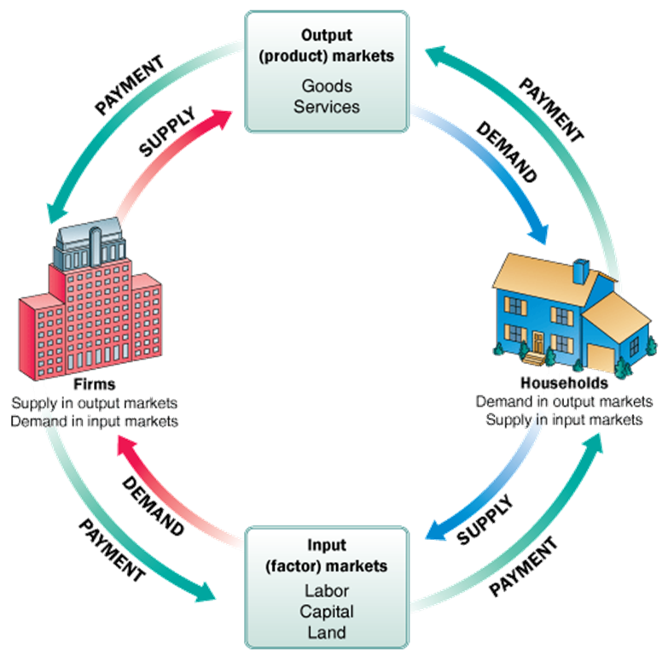
FIGURE 3.1 The Circular Flow of Economic Activity
Diagrams like this one show the circular flow of economic activity, hence the name circular flow diagram. Here goods and services flow clockwise: Labor services supplied by households flow to firms, and goods and services produced by firms flow to households.
Payment (usually money) flows in the opposite (counterclockwise) direction: Payment for goods and services flows from households to firms, and payment for labor services flows from firms to households.
Note: Color Guide—In this figure households are depicted in blue, and firms are depicted in red. From now on, all diagrams relating to the behavior of households will be blue or shades of blue, and all diagrams relating to the behavior of firms will be red or shades of red. The green color indicates a monetary flow.

Slide 6
Input Markets and Output Markets: The Circular Flow (2 of 4)
labor market The input/factor market in which households supply work for wages to firms that demand labor.
capital market The input/factor market in which households supply their savings, for interest or for claims to future profits, to firms that demand funds to buy capital goods.

Slide 7
Input Markets and Output Markets: The Circular Flow (3 of 4)
land market The input/factor market in which households supply land or other real property in exchange for rent.
factors of production The inputs into the production process. Land, labor, and capital are the three key factors of production.

Slide 8
Input Markets and Output Markets: The Circular Flow (4 of 4)
Input and output markets are connected through the behavior of both firms and households.
Firms determine the quantities and character of outputs produced and the types and quantities of inputs demanded.
Households determine the types and quantities of products demanded and the quantities and types of inputs supplied.

Slide 9
Demand in Product/Output Markets (1 of 2)
A household’s decision about what quantity of a particular output, or product, to demand depends on a number of factors, including:
  The price of the product in question
  The income available to the household
  The household’s amount of accumulated wealth
  The prices of other products available to the household
  The household’s tastes and preferences
  The household’s expectations about future income, wealth, and prices

Slide 10
Demand in Product/Output Markets (2 of 2)
quantity demanded The amount (number of units) of a product that a household would buy in a given period if it could buy all it wanted at the current market price.
It is important to focus on the price change alone with the ceteris paribus, or “all else equal,” assumption.

Slide 11
Changes in Quantity Demanded versus Changes in Demand
Changes in the price of a product affect the quantity demanded per period.
Changes in any other factor, such as income or preferences, affect demand.
Thus, we say that an increase in the price of Coca-Cola is likely to cause a decrease in the quantity of Coca-Cola demanded. However, we say that an increase in income is likely to cause an increase in the demand for most goods.

Slide 12
Price and Quantity Demanded: The Law of Demand (1 of 3)
demand schedule Shows how much of a given product a household would be willing to buy at different prices for a given time period.
demand curve A graph illustrating how much of a given product a household would be willing to buy at different prices.

Slide 13
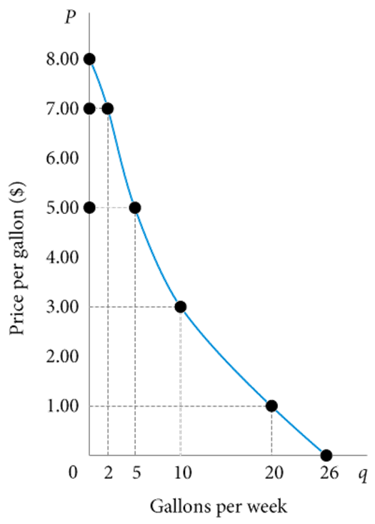
TABLE 3.1 Alex’s Demand Schedule for Gasoline
FIGURE 3.2 Alex’s Demand Curve
Price (per gallon) | Quantity Demanded (gallons per week)
$8.00 | 0
7.00 | 2
6.00 | 3
5.00 | 5
4.00 | 7
3.00 | 10
2.00 | 14
1.00 | 20
0.00 | 26
The relationship between price (P) and quantity demanded (q) presented graphically is called a demand curve.
Demand curves have a negative slope, indicating that lower prices cause quantity demanded to increase.
Note that Alex’s demand curve is blue; demand in product markets is determined by household choice.

Slide 14
Price and Quantity Demanded: The Law of Demand (2 of 3)
Demand Curves Slope Downward
law of demand The negative relationship between price and quantity demanded: Ceteris paribus, as price rises, quantity demanded decreases; as price falls, quantity demanded increases during a given period of time, all other things remaining constant.
It is reasonable to expect quantity demanded to fall when price rises, ceteris paribus, and to expect quantity demanded to rise when price falls, ceteris paribus.
A demand curve has a negative slope.

Slide 15
Price and Quantity Demanded: The Law of Demand (3 of 3)
Other Properties of Demand Curves
To summarize what we know about the shape of demand curves:
  They have a negative slope.
  They intersect the quantity (X) axis, a result of time limitations and diminishing marginal utility.
  They intersect the price (Y) axis, a result of limited income and wealth.
The actual shape of an individual household demand curve depends on the unique tastes and preferences of the household and other factors.

Slide 16
Other Determinants of Household Demand (1 of 3)
Income and Wealth
income The sum of all a household’s wages, salaries, profits, interest payments, rents, and other forms of earnings in a given period of time. It is a flow measure.
wealth or net worth The total value of what a household owns minus what it owes. It is a stock measure.

Slide 17
Other Determinants of Household Demand (2 of 3)
Income and Wealth
normal goods Goods for which demand goes up when income is higher and for which demand goes down when income is lower.
inferior goods Goods for which demand tends to fall when income rises.

Slide 18
Other Determinants of Household Demand (3 of 3)
Prices of Other Goods and Services
substitutes Goods that can serve as replacements for one another; when the price of one increases, demand for the other increases.
perfect substitutes Identical products.
complements, complementary goods Goods that “go together”; a decrease in the price of one results in an increase in demand for the other and vice versa.

Slide 19

ECONOMICS IN PRACTICE
Have You Bought This Textbook?
One might think that the total number of textbooks, used plus new, should match class enrollment. After all, the text is required!
Economists found that the higher the textbook price, the more text sales fell below class enrollments.
Students found substitutes when textbook prices were high.
THINKING PRACTICALLY
If you were to construct a demand curve for a required text in a course, where would that demand curve intersect the horizontal axis?
In the year before a new edition of a text is published, many college bookstores will not buy the older edition. Given this fact, what do you think happens to the gap between enrollments and new plus used book sales in the year before a new edition of a text is expected?

Slide 20
Other Determinants of Household Demand ( 1 of 2)
Tastes and Preferences
Changes in preferences can and do manifest themselves in market behavior.
Within the constraints of prices and incomes, preference shapes the demand curve, but it is difficult to generalize about tastes and preferences.

Slide 21
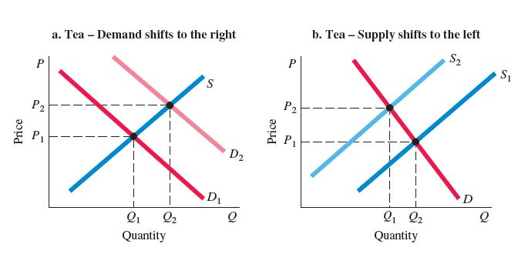
ECONOMICS IN PRACTICE
People Drink Tea on Rainy Days
Tea is a popular beverage among Asians, Americans, and Europeans, especially during rainy seasons.
But some economists recently found that the choices were heavily influenced by temporary weather changes, production, and other factors in the region.
While tea has become a common health drink only some countries have a suitable a climate to grow tea leaves. Thus, a fall in supply outweighs the increase in demand, leading to an increase in equilibrium price, but a decrease in equilibrium quantity.
THINKING PRACTICALLY
When demand and supply curves shift simultaneously, what would be the factors that determine the magnitude of the changes in equilibrium price and quantity?

Slide 22
Other Determinants of Household Demand ( 2 of 2)
Expectations
What you decide to buy today certainly depends on today’s prices and your current income and wealth.
Increasingly, economic theory has come to recognize the importance of expectations.
It is important to understand that demand depends on more than just current incomes, prices, and tastes.

Slide 23
Shifts of Demand versus Movement along a Demand Curve ( 1 of 2)
shift of a demand curve The change that takes place in a demand curve corresponding to a new relationship between quantity demanded of a good and price of that good. The shift is brought about by a change in the original conditions.
movement along a demand curve The change in quantity demanded brought about by a change in price.

Slide 24
TABLE 3.2 Shift of Alex’s Demand Schedule Resulting from an Increase in Income
 | Schedule D₀ | Schedule D₁
 | Quantity Demanded | Quantity Demanded
Price (per Gallon) | (Gallons per Week at an Income of $500 per Week) | (Gallons per Week at an Income of $700 per Week)
$8.00 | 0 | 3
7.00 | 2 | 5
6.00 | 3 | 7
5.00 | 5 | 10
4.00 | 7 | 12
3.00 | 10 | 15
2.00 | 14 | 19
1.00 | 20 | 24
0.00 | 26 | 30

Slide 25
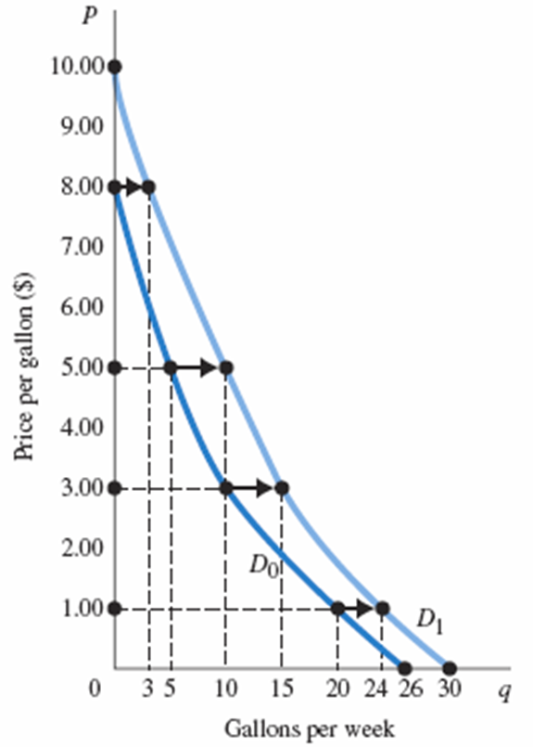
FIGURE 3.3 Shift of a Demand Curve Following a Rise in Income
When the price of a good changes, we move along the demand curve for that good.
When any other factor that influences demand changes (income, tastes, and so on), the demand curve shifts, in this case from D₀ to D₁.
Gasoline is a normal good, so an income increase shifts the curve to the right.

Slide 26
Shifts of Demand versus Movement along a Demand Curve (2 of 2)
Change in price of a good or service leads to
change in quantity demanded (movement along a demand curve).
Change in income, preferences, or prices of other goods or services leads to
change in demand (shift of a demand curve).

Slide 27
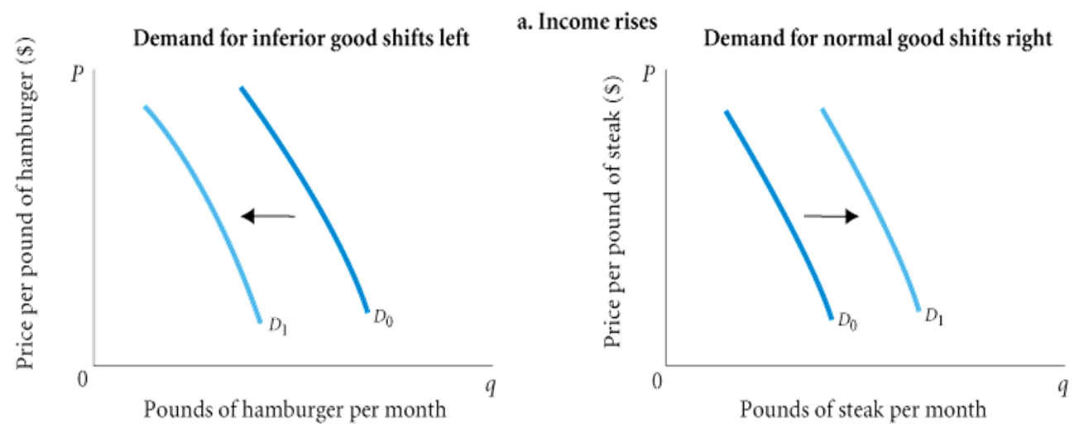
FIGURE 3.4 Shifts versus Movement along a Demand Curve (1 of 2)
a. When income increases, the demand for inferior goods shifts to the left, and the demand for normal goods shifts to the right.

Slide 28
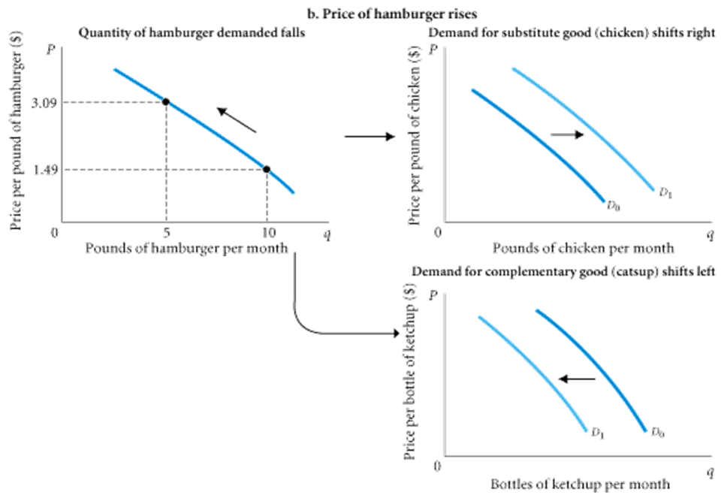
FIGURE 3.4 Shifts versus Movement along a Demand Curve
(cont’d 2 of 2)
b. If the price of hamburger rises, the quantity of hamburger demanded declines; this is a movement along the demand curve.
The same price rise for hamburger would shift the demand for chicken (a substitute for hamburger) to the right and the demand for ketchup (a complement to hamburger) to the left.

Slide 29
From Household Demand to Market Demand
market demand The sum of all the quantities of a good or service demanded per period by all the households buying in the market for that good or service.

Slide 30
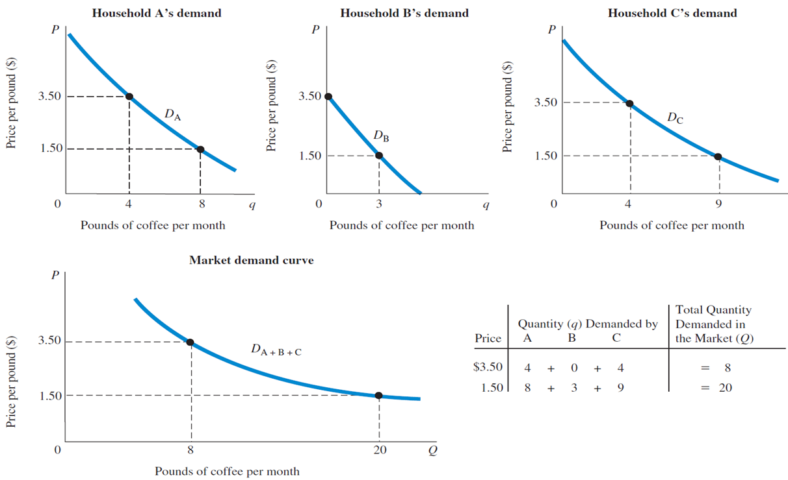
FIGURE 3.5 Deriving Market Demand from Individual Demand Curves
Total demand in the marketplace is simply the sum of the demands of all the households shopping in a particular market. It is the sum of all the individual demand curves—that is, the sum of all the individual quantities demanded at each price.

Slide 31
Supply in Product/Output Markets
Firms build factories, hire workers, and buy raw materials because they believe they can sell the products they make for more than it costs to produce them.
profit The difference between revenues and costs.

Slide 32
Price and Quantity Supplied: The Law of Supply (1 of 2)
quantity supplied The amount of a particular product that a firm would be willing and able to offer for sale at a particular price during a given time period.
supply schedule Shows how much of a product firms will sell at alternative prices.

Slide 33
Price and Quantity Supplied: The Law of Supply (2 of 2)
law of supply The positive relationship between price and quantity of a good supplied: An increase in market price, ceteris paribus, will lead to an increase in quantity supplied, and a decrease in market price will lead to a decrease in quantity supplied.
supply curve A graph illustrating how much of a product a firm will sell at different prices.

Slide 34
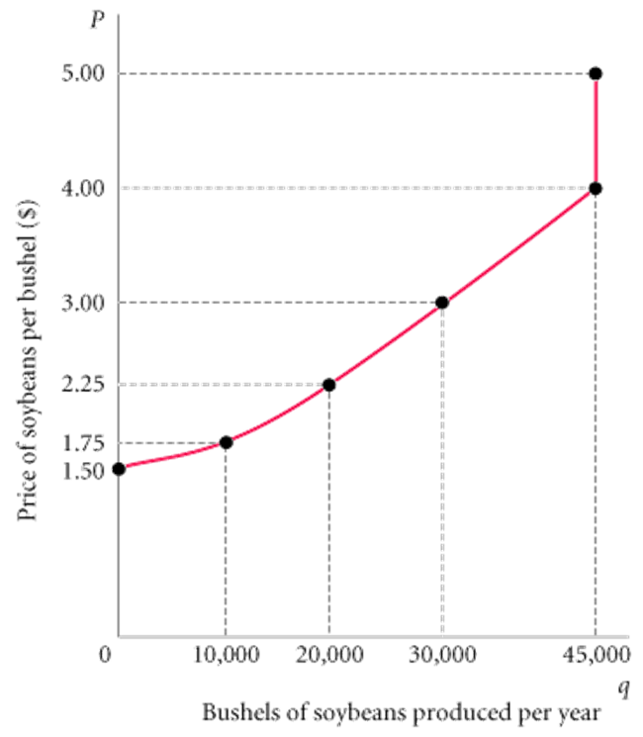
TABLE 3.3 Clarence Brown’s Supply Schedule for Soybeans
FIGURE 3.6 Clarence Brown’s Individual Supply Curve
Price (per Bushel) | Quantity Supplied (Bushels per Year)
$1.50 | 0
1.75 | 10,000
2.25 | 20,000
3.00 | 30,000
4.00 | 45,000
5.00 | 45,000
A producer will supply more when the price of output is higher. The slope of a supply curve is positive.
Note that the supply curve is red: Supply is determined by choices made by firms.

Slide 35
Other Determinants of Supply (1 of 2)
The Cost of Production
For a firm to make a profit, its revenue must exceed its costs.
Cost of production depends on a number of factors, including the available technologies and the prices and quantities of the inputs needed by the firm (labor, land, capital, energy, and so on).

Slide 36
Other Determinants of Supply (2 of 2)
The Prices of Related Products
Assuming that its objective is to maximize profits, a firm’s decision to supply depends on:
  The price of the good or service
  The cost of producing the product, which in turn depends on:
    The price of required inputs (labor, capital, and land)
    The technologies that can be used to produce the product
  The prices of related products

Slide 37
Shift of Supply versus Movement along a Supply Curve ( 1 of 2)
movement along a supply curve The change in quantity supplied brought about by a change in price.
shift of a supply curve The change that takes place in a supply curve corresponding to a new relationship between quantity supplied of a good and the price of that good. The shift is brought about by a change in the original conditions.

Slide 38
TABLE 3.4 Shift of Supply Schedule for Soybeans following Development of a New Disease-Resistant Seed Strain
 | Schedule S₀ | Schedule S₁
Price (per Bushel) | Quantity Supplied (Bushels per Year Using Old Seed) | Quantity Supplied (Bushels per Year Using New Seed)
$1.50 | 0 | 5,000
1.75 | 10,000 | 23,000
2.25 | 20,000 | 33,000
3.00 | 30,000 | 40,000
4.00 | 45,000 | 54,000
5.00 | 45,000 | 54,000

Slide 39
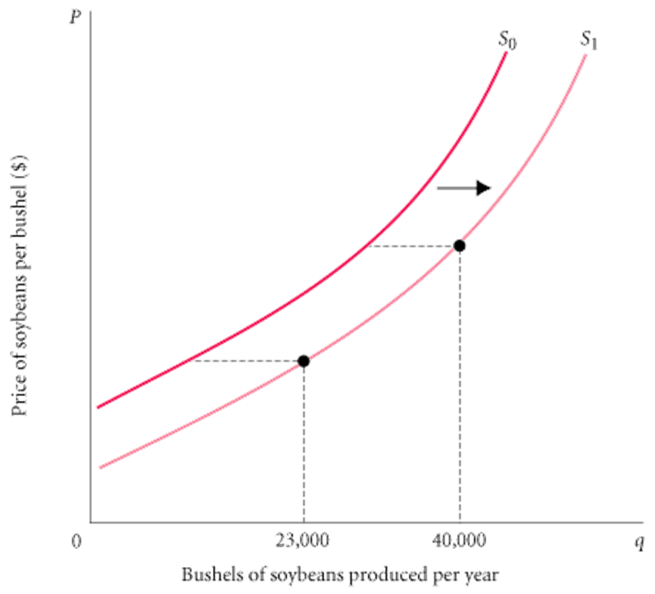
FIGURE 3.7 Shift of the Supply Curve for Soybeans Following Development of a New Seed Strain
When the price of a product changes, we move along the supply curve for that product; the quantity supplied rises or falls.
When any other factor affecting supply changes, the supply curve shifts.

Slide 40
Shift of Supply versus Movement along a Supply Curve (2 of 2)
It is very important to distinguish between movements along supply curves (changes in quantity supplied) and shifts in supply curves (changes in supply):
Change in price of a good or service leads to
change in quantity supplied (movement along a supply curve).
Change in costs, input prices, technology, or prices of related goods and services leads to
change in supply (shift of a supply curve).

Slide 41
From Individual Supply to Market Supply
market supply The sum of all that is supplied each period by all producers of a single product.

Slide 42
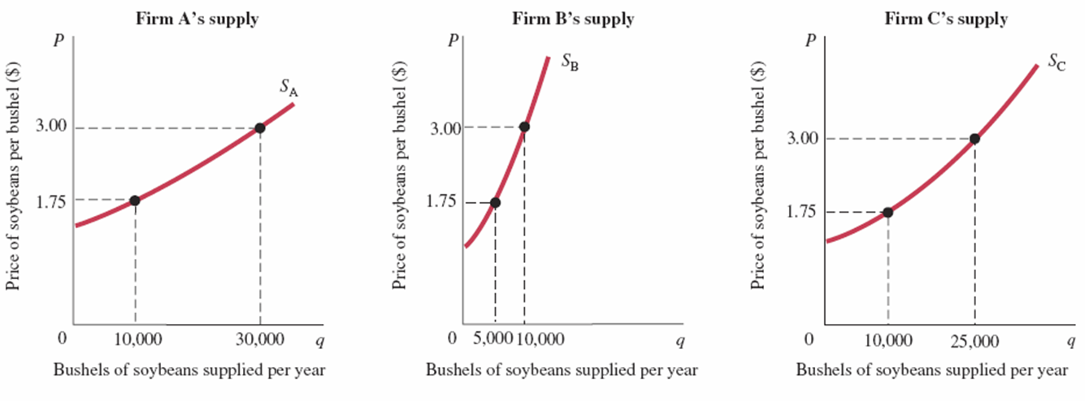
FIGURE 3.8 Deriving Market Supply from Individual Firm Supply Curves
Total supply in the marketplace is the sum of all the amounts supplied by all the firms selling in the market. It is the sum of all the individual quantities supplied at each price.

Slide 43
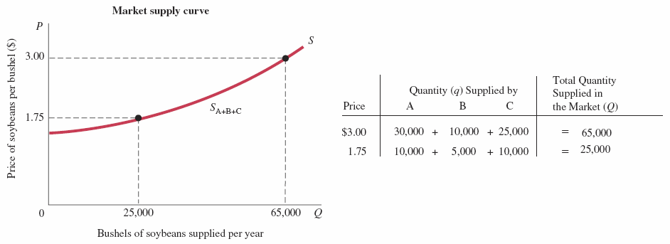
FIGURE 3.8 Deriving Market Supply from Individual Firm Supply Curves (cont’d)
Total supply in the marketplace is the sum of all the amounts supplied by all the firms selling in the market. It is the sum of all the individual quantities supplied at each price.

Slide 44
Market Equilibrium
equilibrium The condition that exists when quantity supplied and quantity demanded are equal. At equilibrium, there is no tendency for price to change.
Excess Demand
excess demand or shortage The condition that exists when quantity demanded exceeds quantity supplied at the current price.

Slide 45
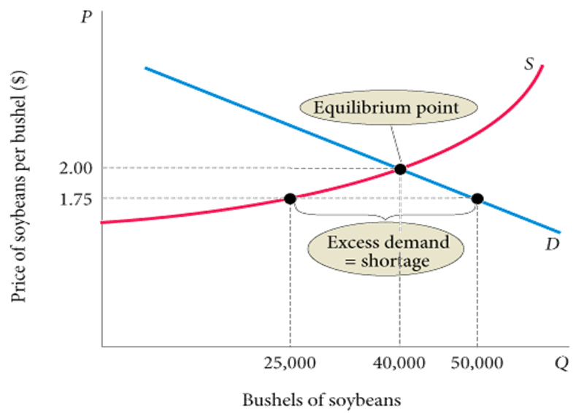
FIGURE 3.9 Excess Demand, or Shortage
At a price of $1.75 per bushel, quantity demanded exceeds quantity supplied.
When excess demand exists, there is a tendency for price to rise.
When quantity demanded equals quantity supplied, excess demand is eliminated and the market is in equilibrium.
Here the equilibrium price is $2.00, and the equilibrium quantity is 40,000 bushels.
Here the equilibrium price is $2.00, and the equilibrium quantity is 40,000 bushels.

Slide 46
Excess Supply
excess supply or surplus The condition that exists when quantity supplied exceeds quantity demanded at the current price.
When quantity supplied exceeds quantity demanded at the current price, the price tends to fall.
When price falls, quantity supplied is likely to decrease, and quantity demanded is likely to increase until an equilibrium price is reached where quantity supplied and quantity demanded are equal.

Slide 47
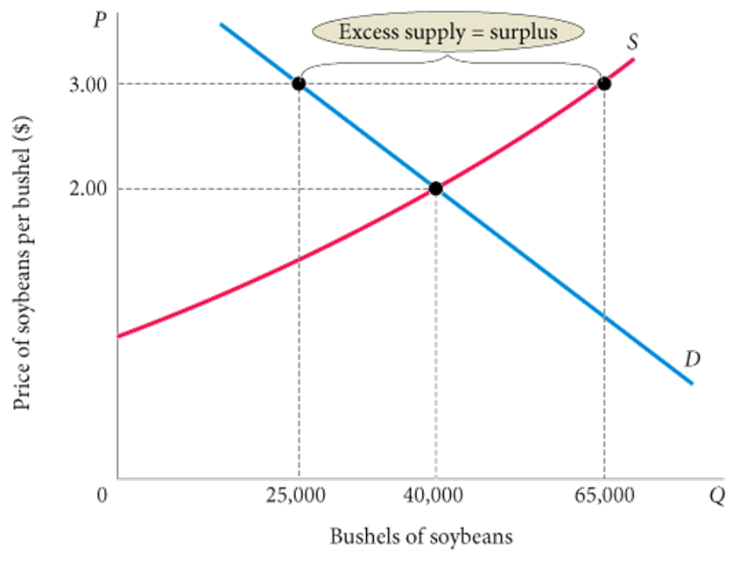
FIGURE 3.10 Excess Supply, or Surplus
At a price of $3.00, quantity supplied exceeds quantity demanded by 40,000 bushels.
This excess supply will cause the price to fall.

Slide 48
Changes in Equilibrium
When supply and demand curves shift, the equilibrium price and quantity change.

Slide 49
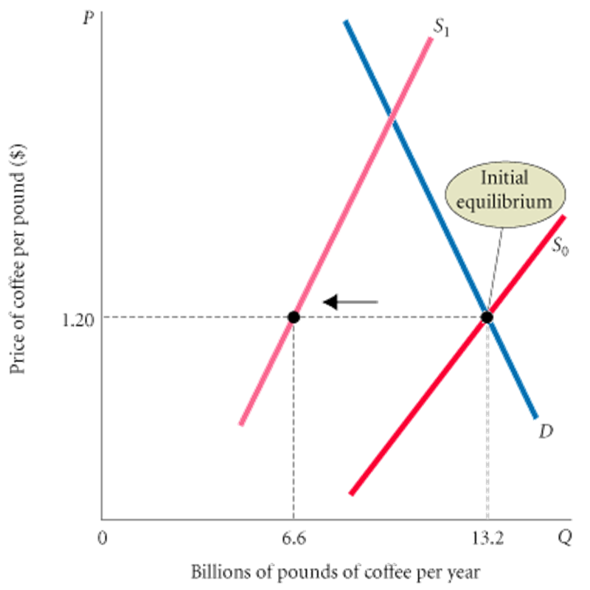
FIGURE 3.11 The Coffee Market: A Shift of Supply and Subsequent Price Adjustment
Before the freeze, the coffee market was in equilibrium at a price of $1.20 per pound.
At that price, quantity demanded equaled quantity supplied.
The freeze shifted the supply curve to the left (from S₀ to S₁), increasing the equilibrium price to $2.40.

Slide 50

ECONOMICS IN PRACTICE
Quinoa
Quinoa, a high-protein grain, was once eaten mostly by people in Peru and Bolivia.
Growth in vegetarianism shifted the demand curve for quinoa to the right, resulting in higher prices.
Despite new farmer entry in response to higher quinoa prices, the particular nature of the production process limited the amount of the shift.
THINKING PRACTICALLY
Use a graph to show the movement in prices and quantities described in the quinoa market.

Slide 51
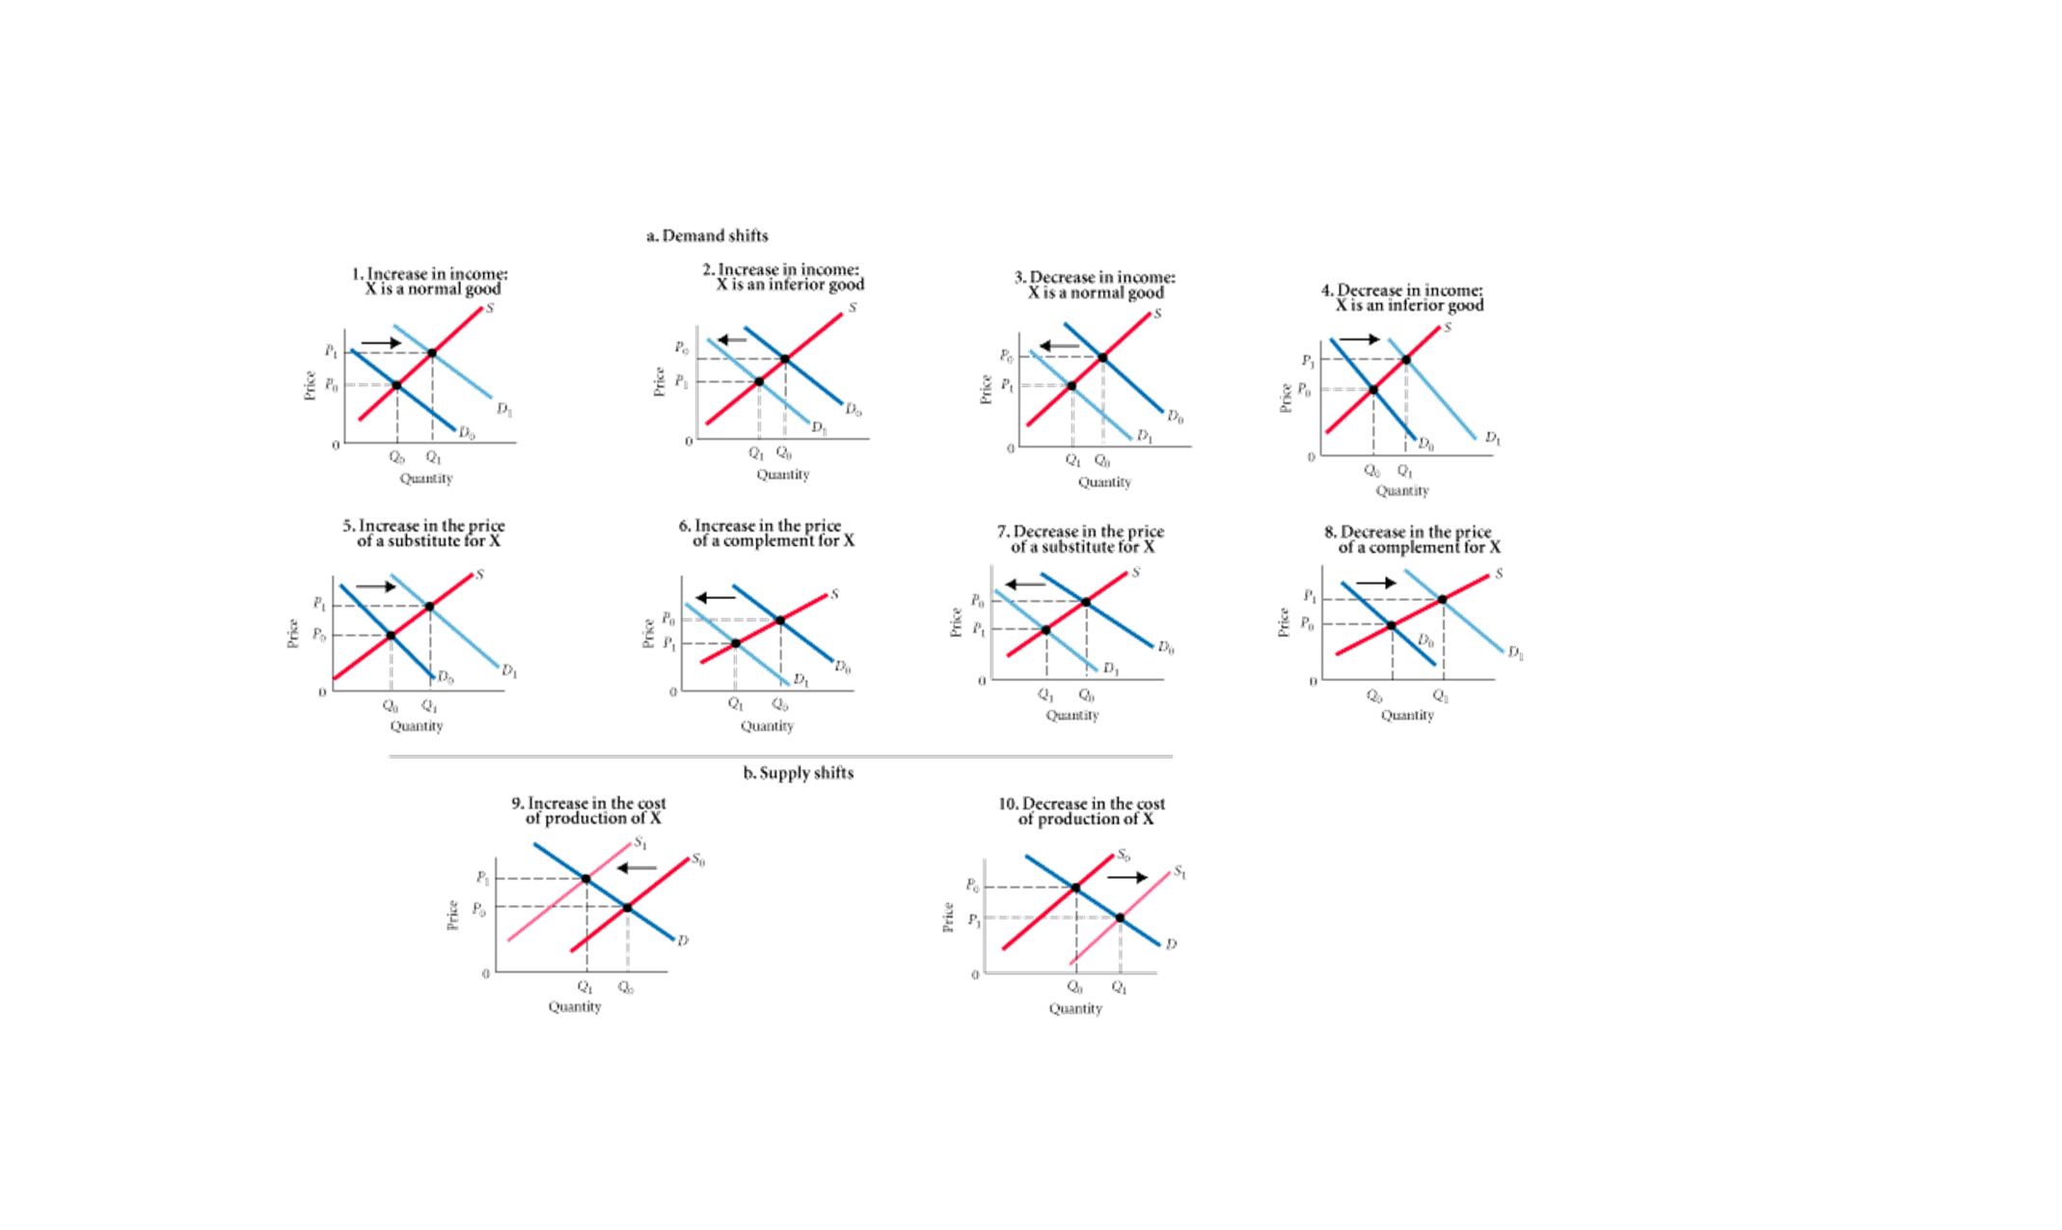
FIGURE 3.12 Examples of Supply and Demand Shifts for Product X

Slide 52
Demand and Supply in Product Markets: A Review (1 of 2)
Important points to remember about the mechanics of supply and demand in product markets:
  A demand curve shows how much of a product a household would buy if it could buy all it wanted at the given price. A supply curve shows how much of a product a firm would supply if it could sell all it wanted at the given price.
  Quantity demanded and quantity supplied are always per time period—that is, per day, per month, or per year.
  The demand for a good is determined by price, household income and wealth, prices of other goods and services, tastes and preferences, and expectations.

Slide 53
Demand and Supply in Product Markets: A Review (2 of 2)
The supply of a good is determined by price, costs of production, and prices of related products. Costs of production are determined by available technologies of production and input prices.
Be careful to distinguish between movements along supply and demand curves and shifts of these curves. When the price of a good changes, the quantity of that good demanded or supplied changes—that is, a movement occurs along the curve. When any other factor changes, the curve shifts, or changes position.
Market equilibrium exists only when quantity supplied equals quantity demanded at the current price.

Slide 54
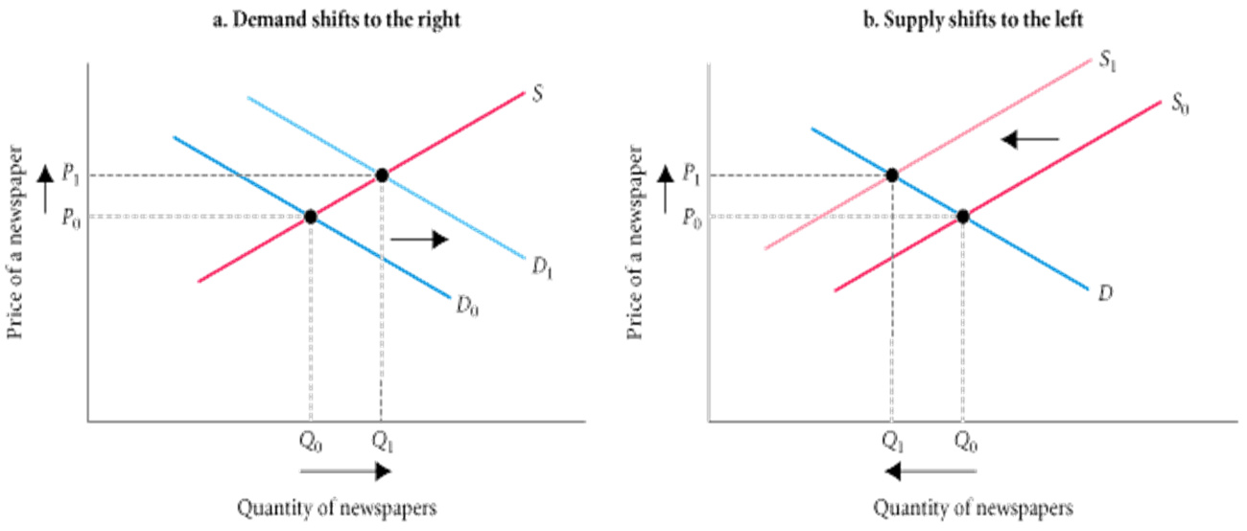
ECONOMICS IN PRACTICE
Why Do the Prices of Newspapers Rise?
In 2006, the average price for a daily edition of a Baltimore newspaper was $0.50. In 2007, the average price had risen to $0.75. Different analysts have different explanations for the higher equilibrium price.

Slide 55
Looking Ahead: Markets and the Allocation of Resources
You can see how markets answer the basic economic questions of what is produced, how it is produced, and who gets what is produced:
    Demand curves reflect what people are willing and able to pay for products; they are influenced by incomes, wealth, preferences, prices of other goods, and expectations.
    Firms in business to make a profit have a good reason to choose the best available technology—lower costs mean higher profits.
    When a good is in short supply, price rises. As it does, only those who are willing and able to continue buying do so.

Slide 56
REVIEW TERMS AND CONCEPTS (1 of 2)
firm
households
income
inferior goods
input or factor markets
labor market
land market
law of demand
law of supply
capital market
complements, complementary goods
demand curve
demand schedule
entrepreneur
equilibrium
excess demand, or shortage
excess supply, or surplus
factors of production
firm
households
income
inferior goods
input or factor markets
labor market
land market
law of demand
law of supply

Slide 57
REVIEW TERMS AND CONCEPTS (2 of 2)
market demand
market supply
movement along a demand curve
movement along a supply curve
normal goods
perfect substitutes
product or output markets
Profit
quantity demanded
quantity supplied
shift of a demand curve
shift of a supply curve
substitutes
supply curve
supply schedule
wealth, or net worth

