Slide 1

Principles of Microeconomics
Twelfth Edition, Global Edition
PART II
THE MARKET SYSTEM
Choices Made by Households and Firms

Slide 2
PART II THE MARKET SYSTEM (1 of 2)
Assumptions for Chapters 6 through 12:
  perfect knowledge The assumption that households possess a knowledge of the qualities and prices of everything available in the market and that firms have all available information concerning wage rates, capital costs, technology, and output prices.
  المعرفة الكاملة: الافتراض بأن الأسر تمتلك معرفة بصفات وأسعار كل شيء متاح في السوق وأن الشركات لديها جميع المعلومات المتاحة المتعلقة بمعدلات الأجور وتكاليف رأس المال والتكنولوجيا وأسعار الإنتاج.

Slide 3
PART II THE MARKET SYSTEM (2 of 2)
perfect competition An industry structure in which there are many firms, each being small relative to the industry and producing virtually identical products, and in which no firm is large enough to have any control over prices.
المنافسة الكاملة: هيكل صناعي توجد فيه العديد من الشركات، كل منها صغيرة نسبياً بالنسبة للصناعة وتنتج منتجات متطابقة تقريباً، ولا توجد فيه شركة كبيرة بما يكفي للتحكم في الأسعار.

Slide 4
Products in a perfectly competitive industry are homogeneous.
homogeneous products Undifferentiated outputs; products that are identical to or indistinguishable from one another.
سلع متطابقة تمامًا، لا يمكن للمستهلك أن يميّز بينها بغض النظر عن المنتج الذي صنعها.بمعنى آخر:لا يوجد فرق في:الجودة، الشكل، الطعم العلامة التجارية، بالنسبة للمستهلك، كل الوحدات متشابهة تمامًا.

Slide 5
رابعًا: لماذا هذا مهم في المنافسة الكاملة؟
لأن تجانس السلعة يؤدي إلى:
1️⃣ لا يوجد تمييز بين البائعين
المستهلك لا يهتم بمن يبيع، بل يهتم فقط بالسعر.
2️⃣ المنتج يصبح "آخذًا للسعر"Price Taker)
لا يستطيع رفع السعر، لأن: المستهلك سينتقل فورًا إلى بائع آخر.
3️⃣ الطلب على إنتاج كل منشأة يكون أفقيًا تمامًا
أي أن: أي زيادة في السعر تؤدي لفقدان جميع العملاء.

Slide 6
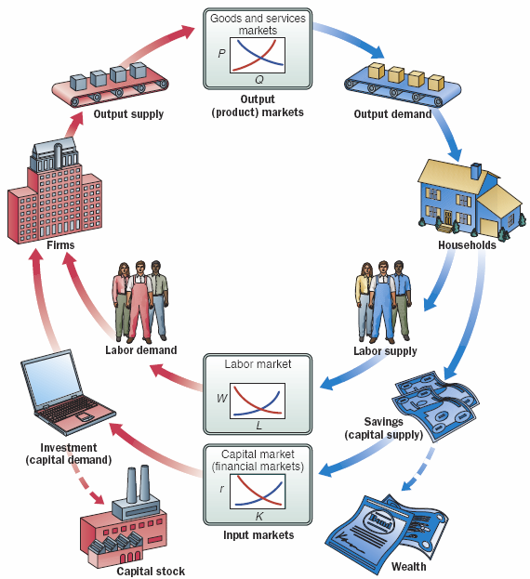
FIGURE II.1 Firm and Household Decisions
Households demand in output markets and supply labor and capital in input markets.
To simplify our analysis, we have not included the government and international sectors in this circular flow diagram. These topics will be discussed in detail later.

Slide 7
الفكرة العامة
الاقتصاد يعمل كـ دورة مستمرة بين:
الأسر Households
المنشآت Firms
أسواق السلع
أسواق عناصر الإنتاج (العمل ورأس المال)
والذي يتحرك داخل هذه الدورة هو:
السلع والخدمات
العمل
رأس المال
النقود
هذا النموذج يوضح أن:
الإنتاج يولّد دخلًا
الدخل يولّد إنفاقًا
الإنفاق يولّد إنتاجًا
والاقتصاد يتحرك في دائرة مستمرة

Slide 8
Principles of Microeconomics
Twelfth Edition, Global Edition
Chapter 6
Household Behavior and Consumer Choice

Slide 9
Chapter 6 Household Behavior and Consumer Choice
Every day people make different decisions.
In this chapter, we will develop a set of principles that can be used to understand decisions in the product market and the labor market.
A theme in this analysis is the idea of constrained choice.
الفكرة المحورية هي "الاختيار المقيّد" Constrained Choice

Slide 10
Household Choice in Output Markets
Every household must make three basic decisions:
  How much of each product, or output, to demand
  How much labor to supply
  How much to spend today and how much to save for the future

Slide 11
The Determinants of Household Demand
Several factors influence the quantity of a given good or service demanded by a single household:
  The price of the product
  The income available to the household
  The household’s accumulated wealth
  The prices of other products available to the household
  The household’s tastes and preferences
  The household’s expectations about future income, wealth, and prices

Slide 12
The Budget Constraint (1 of 3)
budget constraint The limits imposed on household choices by income, wealth, and product prices.
choice set or opportunity set The set of options that is defined and limited by a budget constraint.

Slide 13
TABLE 6.1 Possible Budget Choices of a Person Earning $1,000 per Month after Taxes
Option | Monthly Rent | Food | Other Expenses | Total | Available?
A | $ 400 | $250 | $350 | $1,000 | Yes
B | 600 | 200 | 200 | 1,000 | Yes
C | 700 | 150 | 150 | 1,000 | Yes
D | 1,000 | 100 | 100 | 1,200 | No

Slide 14
The Budget Constraint (2 of 3)
Preferences, Tastes, Trade-offs, and Opportunity Cost
Within the constraints imposed by limited incomes and fixed prices, households are free to choose what they will and will not buy.
التفضيلات (Preferences)
تعني:
كيف يرتب الفرد السلع حسب رغبته.
مثال:
تفضّل القهوة على الشاي
تفضّل السفر على شراء ملابس
الاقتصاد لا يسأل لماذا تفضّل شيئًا،
بل يفترض أن لديك ترتيبًا واضحًا لتفضيلاتك.

Slide 15
A household makes a choice by weighing the good or service that it chooses against all the other things that the same money could buy.
With a limited budget, the real cost of any good or service is the value of the other goods and services that could have been purchased with the same amount of money.

Slide 16
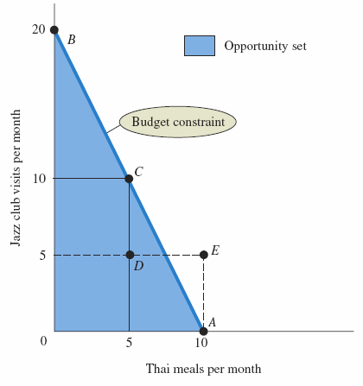
FIGURE 6.1 Budget Constraint and Opportunity Set for
Ann and Tom
A budget constraint separates those combinations of goods and services (e.g., point C) that are available, given limited income, from those that are not (e.g., point E).
The available combinations make up the opportunity set.

Slide 17
The Budget Constraint (3 of 3)
The Budget Constraint More Formally
Both prices and income affect the size of a household’s opportunity set.
real income The set of opportunities to purchase real goods and services available to a household as determined by prices and money income.

Slide 18

The Equation of the Budget Constraint
In general, the budget constraint can be written:
where:
  P_{X} = the price of X
  X = the quantity of X consumed
  P_{Y} = the price of Y
  Y = the quantity of Y consumed
  I = household income

Slide 19
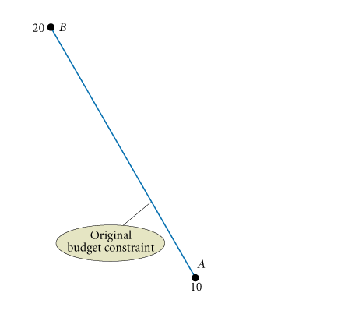
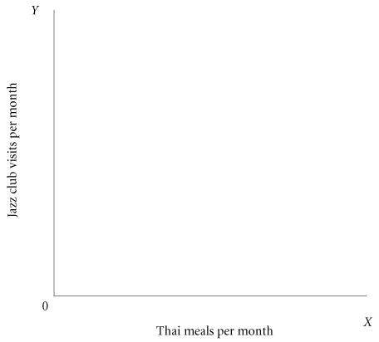
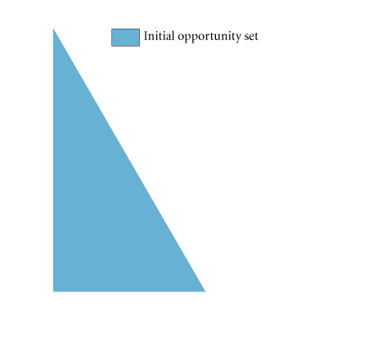
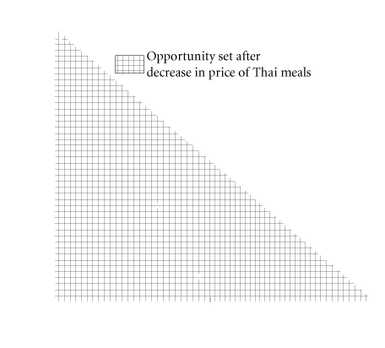
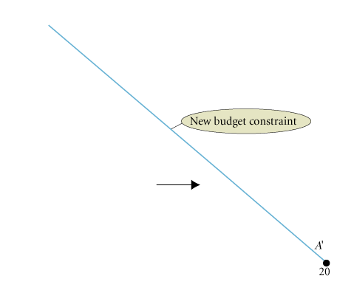
FIGURE 6.2 The Effect of a Decrease in Price on Ann and Tom’s Budget Constraint
When the price of a good decreases, the budget constraint swivels to the right, increasing the opportunities available and expanding choice.

Slide 20
The Basis of Choice: Utility (1 of 2)
utility The satisfaction a product yields
Diminishing Marginal Utility
law of diminishing marginal utility The more of any one good consumed in a given period, the less satisfaction (utility) generated by consuming each additional (marginal) unit of the same good.
كلما زادت الكمية المستهلكة من سلعة معينة خلال فترة زمنية معينة، انخفضت المنفعة الناتجة عن كل وحدة إضافية منها.
مقدار الإشباع أو الرضا الذي يحصل عليه الفرد من استهلاك سلعة أو خدمة.

Slide 21
The Basis of Choice: Utility (2 of 2)
marginal utility (MU) The additional satisfaction gained by the consumption of one more unit of a good or service.
total utility The total satisfaction a product yields.
هي مجموع الإشباع الناتج عن استهلاك عدد معين من الوحدات.
الزيادة في المنفعة الناتجة عن استهلاك وحدة إضافية.

Slide 22
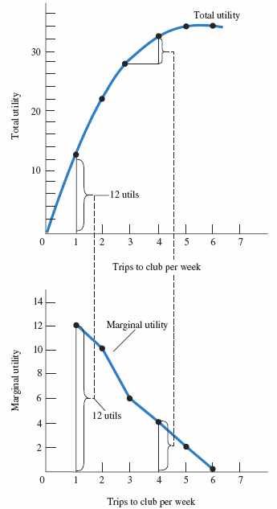
TABLE 6.2 Total Utility and Marginal Utility of Trips to the Club per Week
FIGURE 6.3 Graphs of Frank’s Total and Marginal Utility
Trips to Club | Total Utility | Marginal Utility
1 | 12 | 12
2 | 22 | 10
3 | 28 | 6
4 | 32 | 4
5 | 34 | 2
6 | 34 | 0
Marginal utility is the additional utility gained by consuming one additional unit of a commodity—in this case, trips to the club.
When marginal utility is zero, total utility stops rising.

Slide 23
Allocating Income to Maximize Utility
TABLE 6.3 Allocation of Fixed Expenditure per Week between Two Alternatives
(1) Trips to Club per Week | (2) Total Utility | (3) Marginal Utility (MU) | (4) Price (P) | (5) Marginal Utility per Dollar (MU/P)
1 | 12 | 12 | $3.00 | 4.0
2 | 22 | 10 | 3.00 | 3.3
3 | 28 | 6 | 3.00 | 2.0
4 | 32 | 4 | 3.00 | 1.3
5 | 34 | 2 | 3.00 | 0.7
6 | 34 | 0 | 3.00 | 0
(1) Basketball Games per Week | (2) Total Utility | (3) Marginal Utility (MU) | (4) Price (P) | (5) Marginal Utility per Dollar (MU/P)
1 | 21 | 21 | $6.00 | 3.5
2 | 33 | 12 | 6.00 | 2.0
3 | 42 | 9 | 6.00 | 1.5
4 | 48 | 6 | 6.00 | 1.0
5 | 51 | 3 | 6.00 | 0.5
6 | 51 | 0 | 6.00 | 0

Slide 24

The Utility-Maximizing Rule (1 of 2)
Utility-maximizing consumers spread out their expenditures until the following condition holds:
where MU_{X} is the marginal utility derived from the last unit of X consumed, MU_{Y} is the marginal utility derived from the last unit of Y consumed, P_{X} is the price per unit of X, and P_{Y} is the price per unit of Y.

Slide 25
The Utility-Maximizing Rule (2 of 2)
utility-maximizing rule Equating the ratio of the marginal utility of a good to its price for all goods.
diamond/water paradox A paradox stating that (1) the things with the greatest value in use frequently have little or no value in exchange and (2) the things with the greatest value in exchange frequently have little or no value in use.

Slide 26
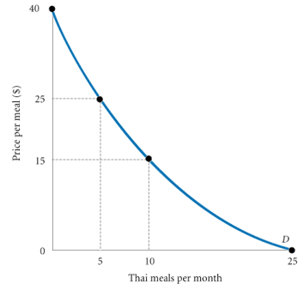
Diminishing Marginal Utility and Downward-Sloping Demand
FIGURE 6.4 Diminishing Marginal Utility and
Downward-Sloping Demand
At a price of $40, the utility gained from even the first Thai meal is not worth the price.
However, a lower price of $25 lures Ann and Tom into the Thai restaurant 5 times a month. (The utility from the sixth meal is not worth $25.)
If the price is $15, Ann and Tom will eat Thai meals 10 times a month—until the marginal utility of a Thai meal drops below the utility they could gain from spending $15 on other goods.
At 25 meals a month, they cannot tolerate the thought of another Thai meal, even if it is free.

Slide 27
Income and Substitution Effects
Another explanation for downward-sloping demand curves centers on income and substitution effects.
The Income Effect
Assuming nothing else changes, a price decline in a product makes you better off because you have more income left over.
The change in consumption of X due to this improvement in well-being is called the income effect of a price change.

Slide 28
The Substitution Effect
When the price of a product falls, that product also becomes relatively cheaper.
A fall in the price of product X might cause a household to shift its purchasing pattern away from substitutes toward X.
This shift is called the substitution effect of a price change.

Slide 29
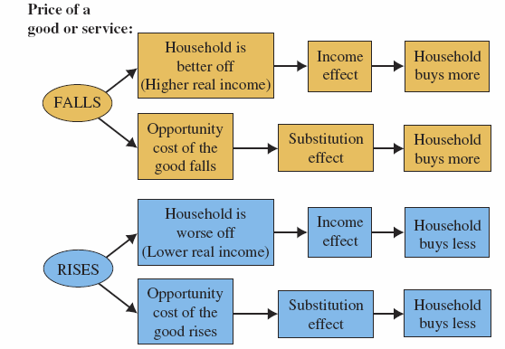
FIGURE 6.5 Income and Substitution Effects of a Price Change
For normal goods, the income and substitution effects work in the same direction.
Higher prices lead to a lower quantity demanded, and lower prices lead to a higher quantity demanded.

Slide 30

ECONOMICS IN PRACTICE
Substitution and Market Baskets
When Mr. Smith shops, he compares the marginal utility of each product he consumes relative to its price in deciding what bundle to buy.
When we artificially restrict Mr. Smith’s ability to substitute goods, we almost inevitably give him a more expensive bundle.
THINKING PRACTICALLY
An employer decides to transfer one of her executives to Europe. “Don’t worry,” she says, “I will increase your salary so that you can afford exactly the same things in your new home city as you can buy here.” Is this the right salary adjustment?

Slide 31
Household Choice in Input Markets
The Labor Supply Decision
As in output markets, households face constrained choices in input markets. They must decide:
  1. Whether to work
  2. How much to work
  3. What kind of a job to take

Slide 32
The Labor Supply Decision
Household members must decide how much labor to supply.
The choices they make are affected by:
  Availability of jobs
  Market wage rates
  Skills they possess
  The limit of 168 hours in a week

Slide 33
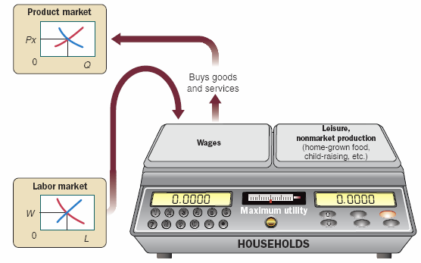
FIGURE 6.6 The Trade-off Facing Households
The decision to enter the workforce involves a trade-off between wages (and the goods and services that wages will buy) on the one hand and leisure and the value of nonmarket production on the other hand.

Slide 34
The Price of Leisure
Trading one good for another involves buying less of one and more of another, so households simply reallocate income from one good to the other.
“Buying” more leisure, however, means reallocating time between work and nonwork activities.
For each hour of leisure that you decide to consume, you give up one hour’s wages.
Thus, the wage rate is the price of leisure.

Slide 35
Income and Substitution Effects of a Wage Change
labor supply curve A curve that shows the quantity of labor supplied at different wage rates. Its shape depends on how households react to changes in the wage rate.

Slide 36

ECONOMICS IN PRACTICE
Uber Drivers
Uber is a company that matches people who are available to use their own cars to drive people around with those who want a ride.
Uber drivers have a great deal of job flexibility in terms of how much they work and when to accept a passenger.
THINKING PRACTICALLY
Why is Uber willing to let drivers be flexible in the number of hours they work?

Slide 37
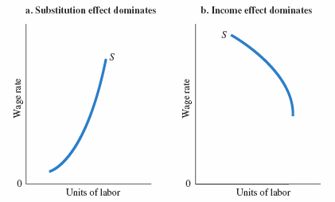
FIGURE 6.7 Two Labor Supply Curves
When the substitution effect outweighs the income effect, the labor supply curve slopes upward (a).
When the income effect outweighs the substitution effect, the result is a “backward bending” labor supply curve: The labor supply curve slopes downward (b).

Slide 38
Saving and Borrowing: Present versus Future Consumption
Changes in interest rates affect household behavior in capital markets.
Empirical evidence indicates that saving tends to increase as the interest rate rises (i.e., the substitution effect is larger than the income effect).
financial capital market The complex set of institutions in which suppliers of capital (households that save) and the demand for capital (firms wanting to invest) interact.

Slide 39
A Review: Households in Output and Input Markets
We now have a rough sketch of the factors that determine output demand and input supply.
In the next three chapters, we turn to firm behavior and explore in detail the factors that affect output supply and input demand.

Slide 40
REVIEW TERMS AND CONCEPTS
budget constraint
choice set or opportunity set
diamond/water paradox
financial capital market
homogeneous products
labor supply curve
law of diminishing marginal utility
marginal utility (MU)
perfect competition
perfect knowledge
real income
total utility
utility
utility-maximizing rule

Slide 41
CHAPTER 6 APPENDIX: Indifference Curves (1 of 2)
Assumptions:
  Goods yield positive marginal utility (i.e., “more is better”).
  The marginal rate of substitution, the ratio at which a household is willing to substitute X for
  Y (MU_{X}/MU_{Y}, ), is diminishing.
  Consumers have the ability to choose among the combinations of goods and services available.
  Consumer choices are consistent with a simple assumption of rationality.

Slide 42
CHAPTER 6 APPENDIX: Indifference Curves (2 of 2)
Assumptions
marginal rate of substitution MU_{X}/MU_{Y} ; the ratio at which a household is willing to substitute good Y for good X.
Deriving Indifference Curves
indifference curve A set of points, each point representing a combination of goods X and Y, all of which yield the same total utility.

Slide 43
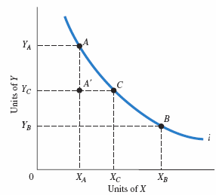
Deriving Indifference Curves
FIGURE 6A.1 An Indifference Curve
An indifference curve is a set of points, each representing a combination of some amount of good X and some amount of good Y, that all yield the same amount of total utility.
The consumer depicted here is indifferent between bundles A and B, B and C, and A and C.
Because “more is better,” our consumer is unequivocally worse off at A' than at A.

Slide 44
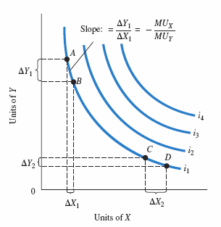
FIGURE 6A.2 A Preference Map: A Family of Indifference Curves
Each consumer has a unique family of indifference curves called a preference map. Higher indifference curves represent higher levels of total utility.

Slide 45


Properties of Indifference Curves
We can show how the trade-off changes more formally by deriving an expression of the slope of an indifference curve.
Rearranging terms, we obtain

Slide 46
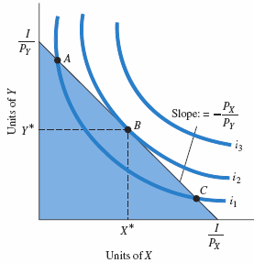
FIGURE 6A.3 Consumer Utility-Maximizing Equilibrium
Consumers will choose the combination of X and Y that maximizes total utility. Graphically, the consumer will move along the budget constraint until the highest possible indifference curve is reached.
At that point, the budget constraint and the indifference curve are tangent. This point of tangency occurs at X* and Y* (point B).

Slide 47
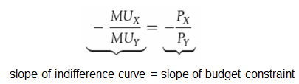

Consumer Choice
The tangency point between the indifference curve and the budget constraint has implications:
  They have the same slope:
  Utility maximization is reached when the marginal utility per dollar spent on X equals the marginal utility per dollar spent on Y:

Slide 48
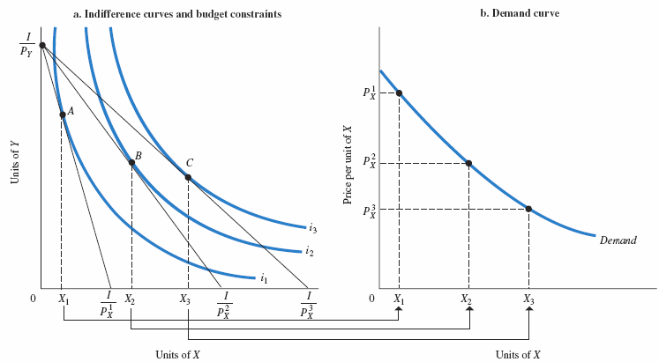
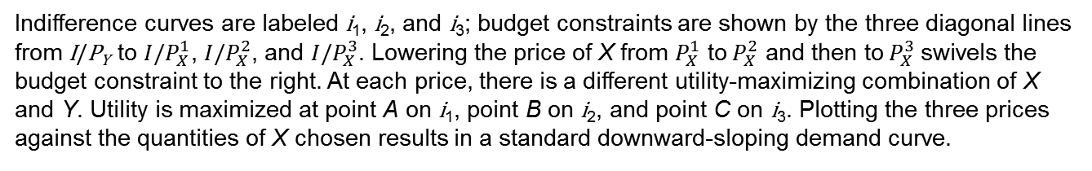
Deriving a Demand Curve from Indifference Curves and Budget Constraints
FIGURE 6A.4 Deriving a Demand Curve from Indifference Curves and Budget Constraint
Indifference curves are labeled i₁, i₂, and i₃; budget constraints are shown by the three diagonal lines from I/P_{Y} to ${I/P}_{X}^{1}$, ${I/P}_{X}^{2}$, and ${I/P}_{X}^{3}$. Lowering the price of X from $P_{X}^{1}$ to${ P}_{X}^{2}$ and then to${ P}_{X}^{3}$swivels the budget constraint to the right. At each price, there is a different utility-maximizing combination of X and Y. Utility is maximized at point A on i₁, point B on i₂, and point C on i₃. Plotting the three prices against the quantities of X chosen results in a standard downward-sloping demand curve.

Slide 49
APPENDIX REVIEW TERMS AND CONCEPTS
indifference curve
marginal rate of substitution
preference map

